Slide 1
Murach’s C# (8th Edition)
Chapter 1
How to get started with Visual Studio

Slide 2
Objectives
Applied
Use Visual Studio to perform any of these operations:
Open and close an existing C# project or solution
Display the Form Designer for each of the forms in a project
Display the Code Editor for each of the forms in a project
Use the Solution Explorer to review the files in a project
Open, hide, and adjust the windows for a project
Build and run a project
Knowledge
Describe the main difference between a desktop app and a web app.
Name three platforms that you can use to develop Windows desktop apps with .NET.

Slide 3
Objectives (continued)
Name three platforms you can use to develop web apps with .NET.
Name three programming languages that you can use to develop .NET applications.
Distinguish between .NET Framework and .NET Core (.NET).
Describe the two main components of .NET.
In general terms, describe the C# compiler, Microsoft Intermediate Language, the assembly, and the Common Language Runtime.
Describe the use of each of these windows in the Visual Studio IDE: Form Designer, Code Editor, and Solution Explorer.
In general terms, describe how to use Visual Studio to target a version of .NET.

Slide 4
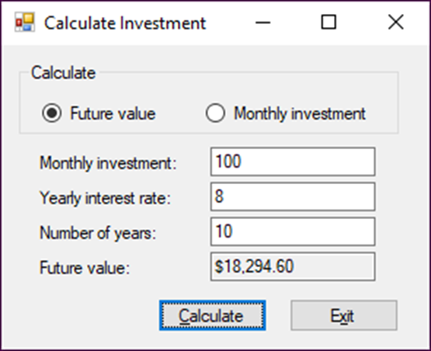
A Windows desktop app

Slide 5
Three platforms for developing Windows desktop apps with .NET
Windows Forms (WinForms)
Windows Presentation Foundation (WPF)
Universal Windows Platform (UWP)

Slide 6
Three platforms for developing web apps with .NET
ASP.NET Web Forms
ASP.NET Core MVC
ASP.NET Core Razor Pages

Slide 7
Visual Studio 2022 editions
Community Edition
Professional Edition
Enterprise Edition

Slide 8
.NET programming languages
C#
Visual Basic
F#

Slide 9
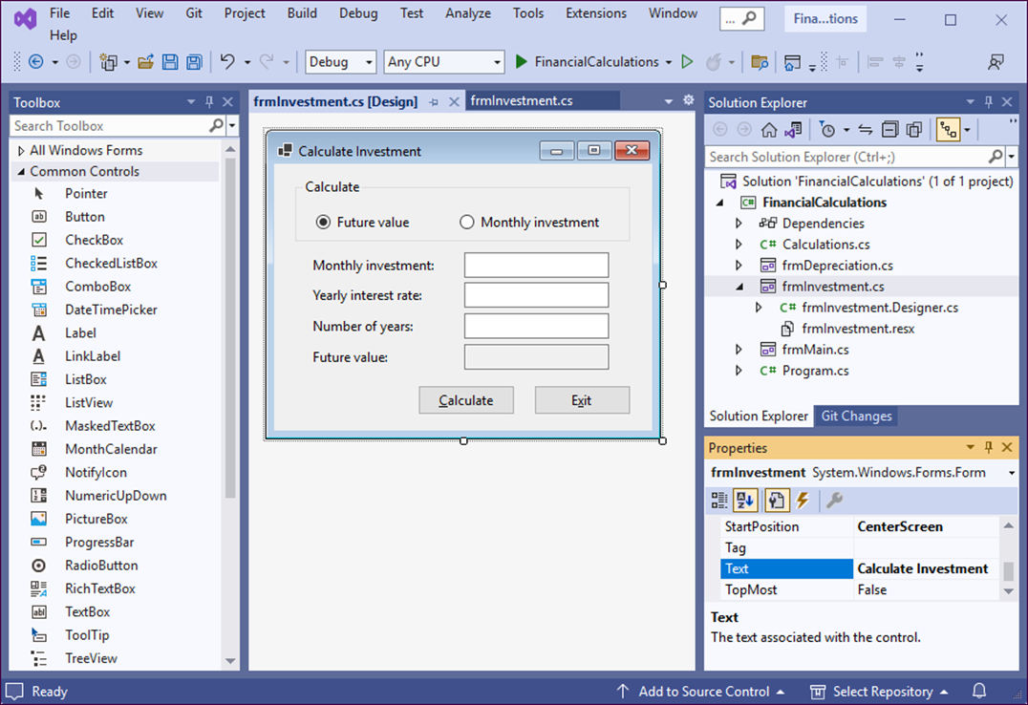
The Visual Studio IDE

Slide 10
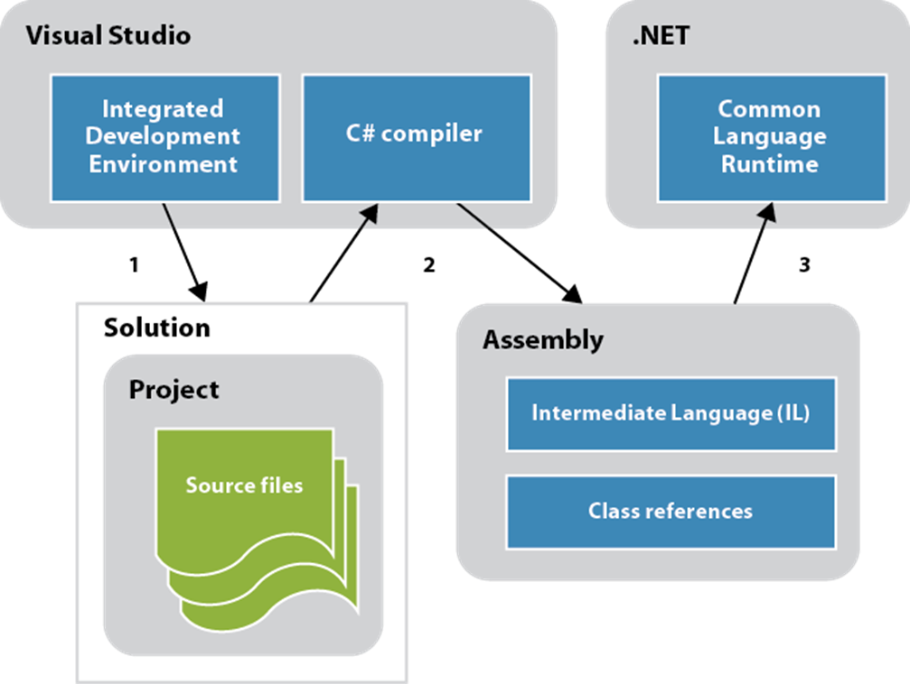
How a C# application is compiled and run

Slide 11
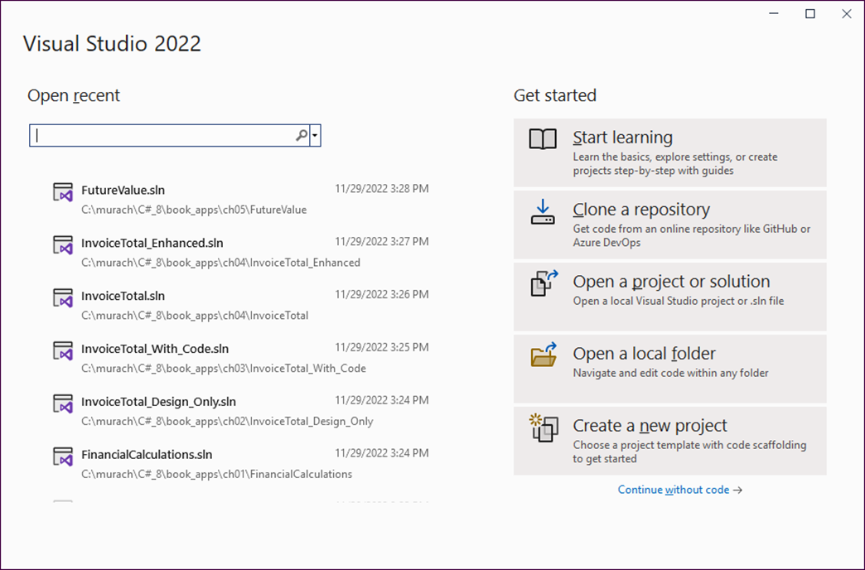
The Visual Studio Start window

Slide 12
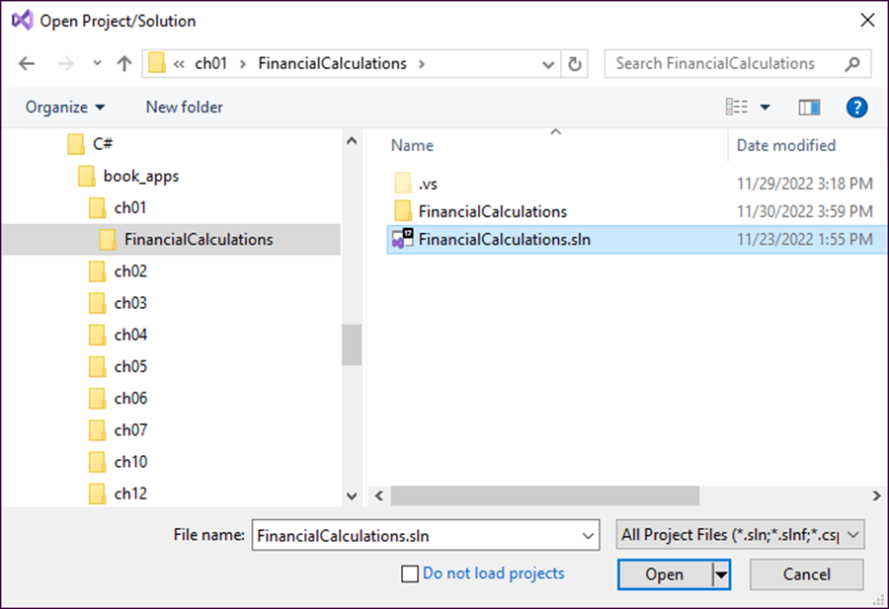
The Open Project/Solution dialog

Slide 13
Visual Studio with the Form Designer displayed

Slide 14
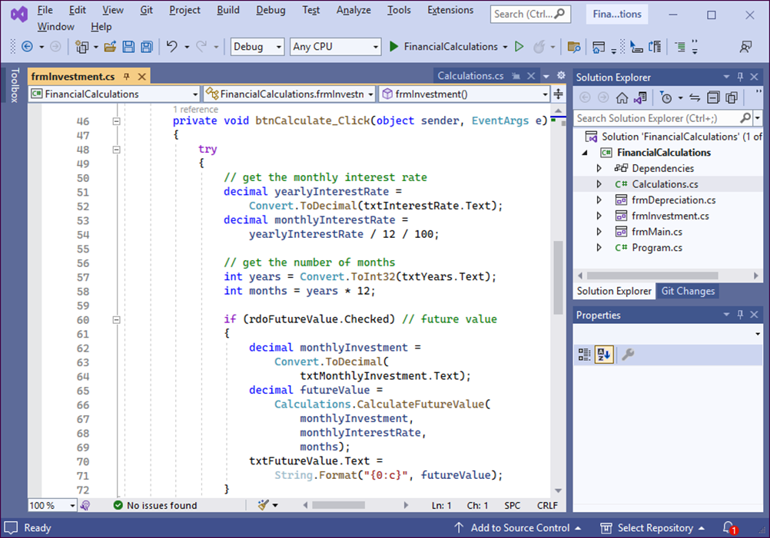
Visual Studio with the Code Editor displayed

Slide 15
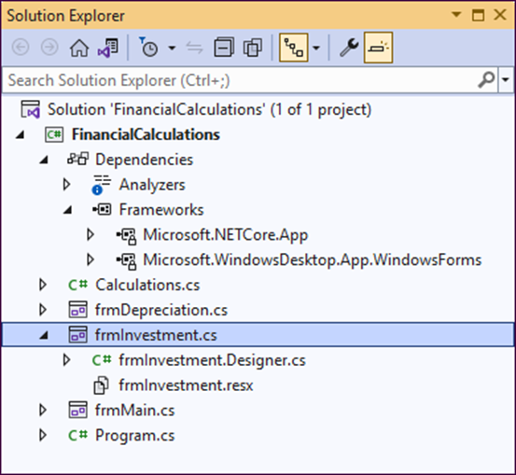
The Solution Explorer

Slide 16
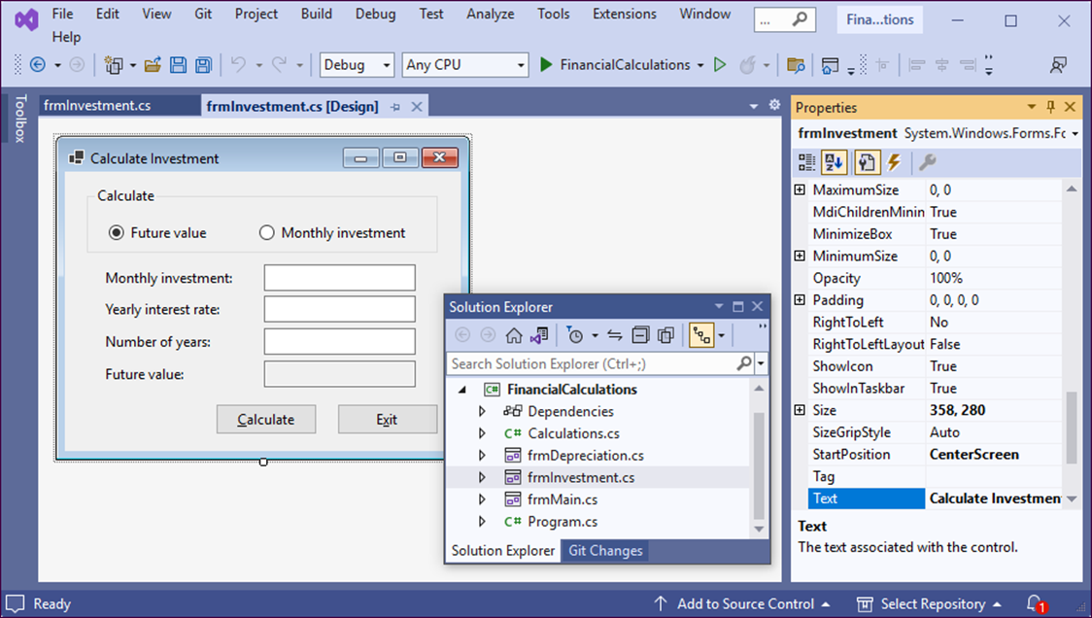
Two floating windows, a hidden window, and a pinned window

Slide 17
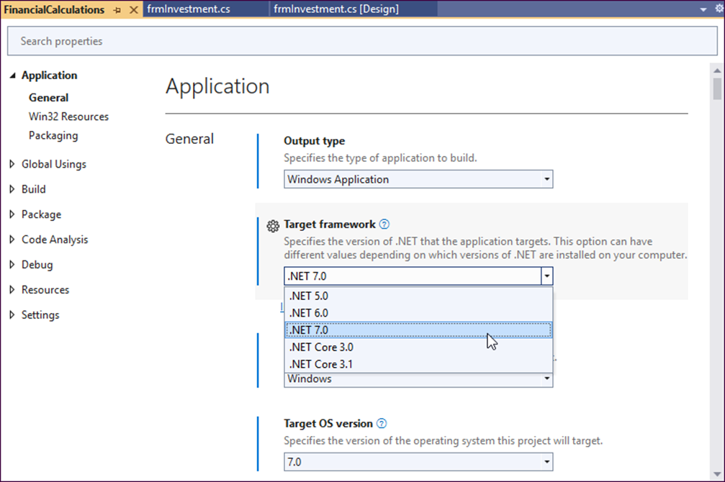
The Project Properties window

Slide 18
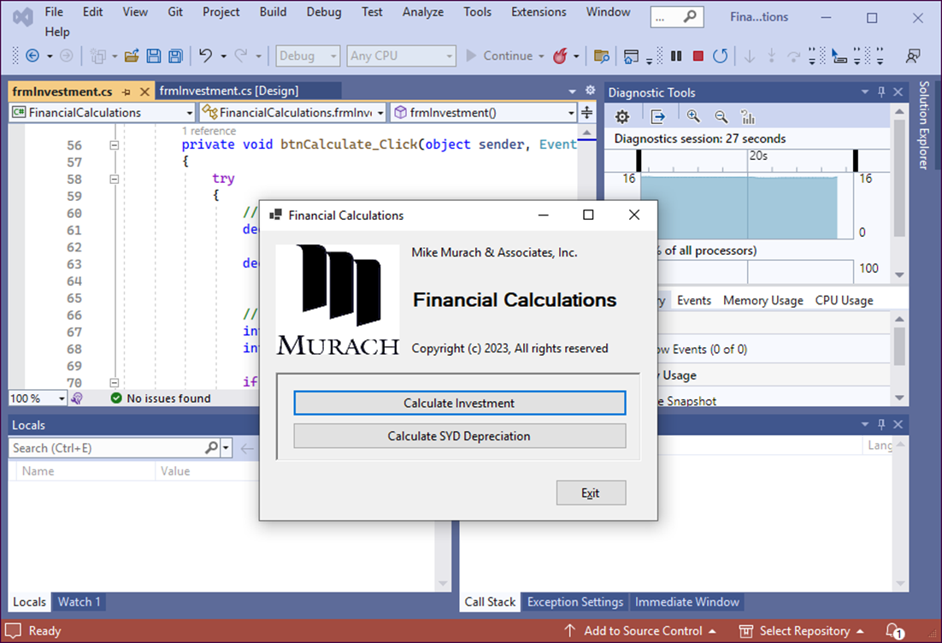
The form that’s displayed when the Financial Calculations project is run

